Slide 1
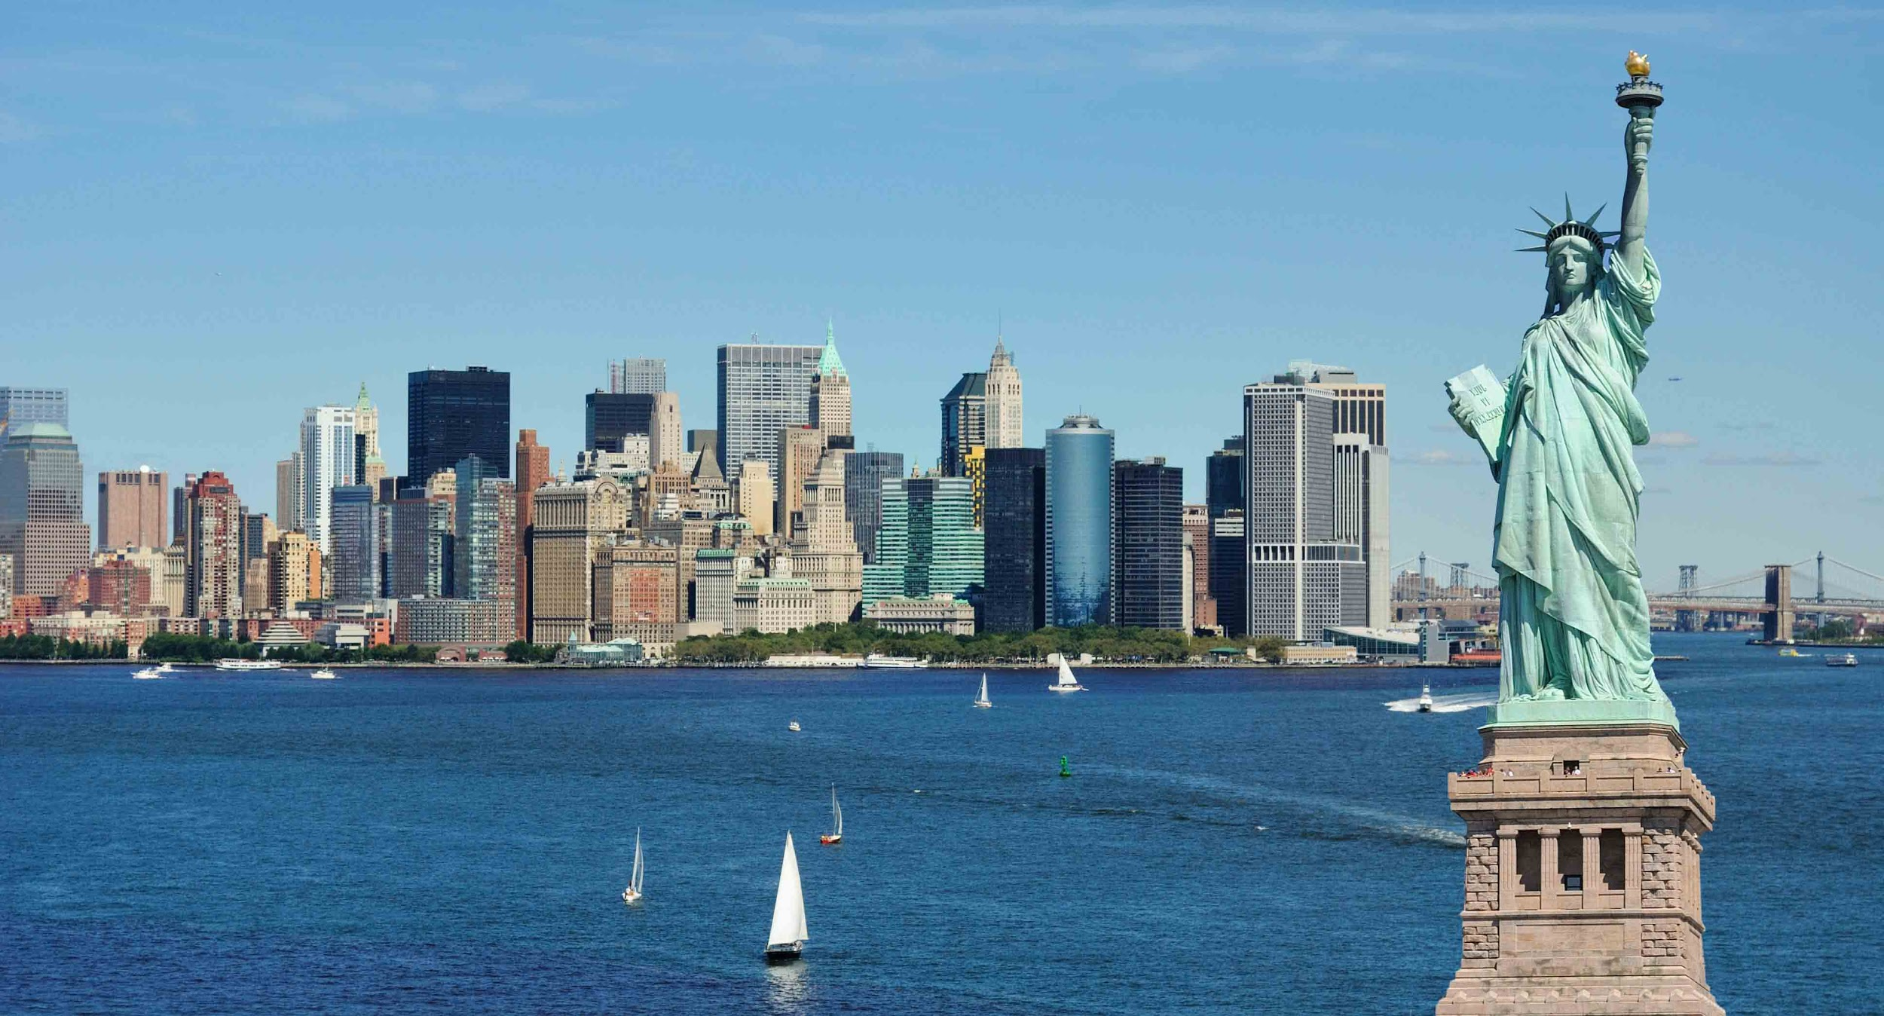
Data Science Capstone Project
By Savan Hirapara

Slide 2
Introduction
The project is about in-depth study of the city of the New York. It is mainly focused on improving someone’s travel or visit to the NYC. It considers the different tourist places, famous landmarks, amazing restaurants and many more.
It is mainly focused on finding how crime in NYC affects the tourism industry. This project also provide deeper understanding on how much a person spend on a particular item like hotel stays, best food/restaurants, visiting landmarks or museums, etc.

Slide 3
Aim Statement
To find the most enjoyable, safe and cheapest option for your next trip to NYC.

Slide 4
Data Source
The data is fetched from the Foursquare, which is best known for its location accuracy of the different landmarks, restaurants, parks, etc.
The developer version is used to get access to premium calls.
The crime data is retrieved from www.nyc.gov¹
*(1 = https://www1.nyc.gov/site/nypd/stats/crime-statistics/citywide-crime-stats.page)

Slide 5
Methodologies
K-shift Clustering
To get to know the famous landmarks, building and parks based on the number of visits made by a tourist. Then I was able to cluster all this information together for further analysis.
Mean shift Clustering
To study the total number of visit made by an tourist over the period of time. It answered the question: What is the total number of visits over 10 years for particular landmark?

Slide 6
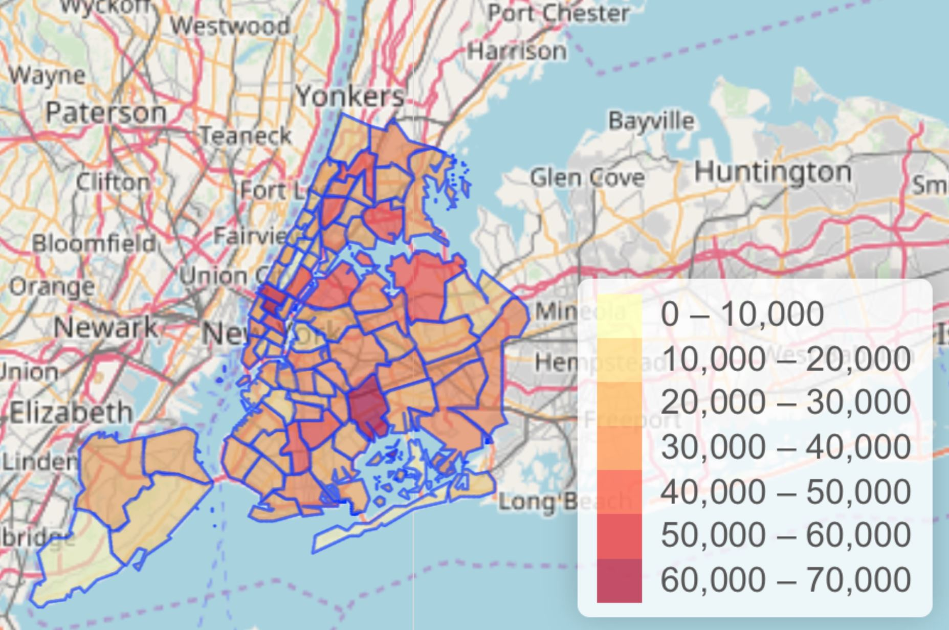
Results

Slide 7
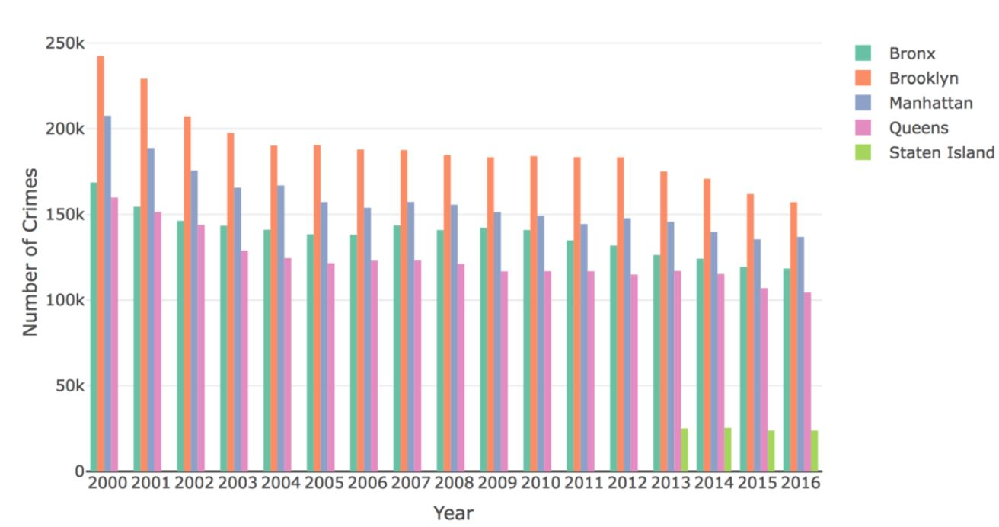
Crime by Borough

Slide 8
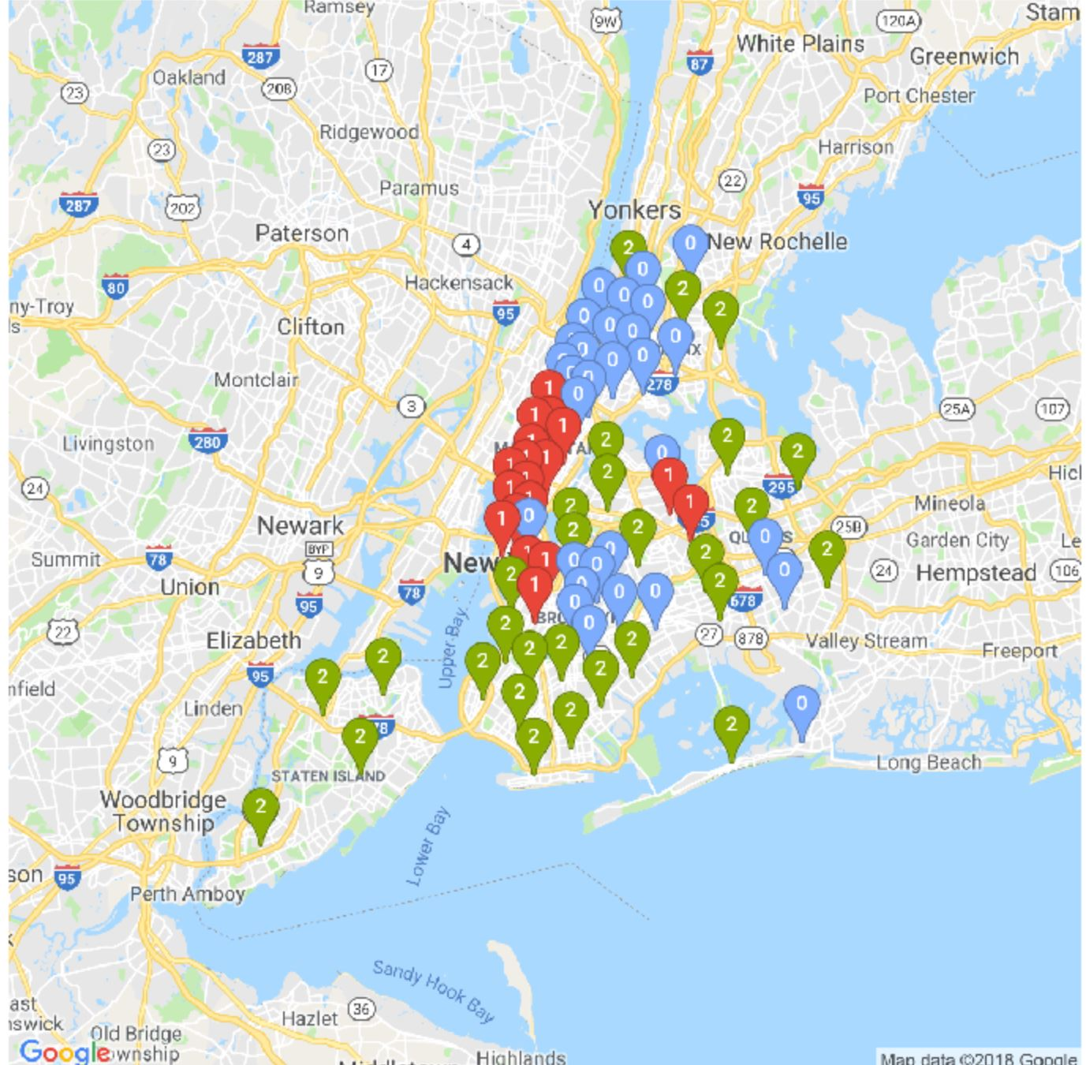
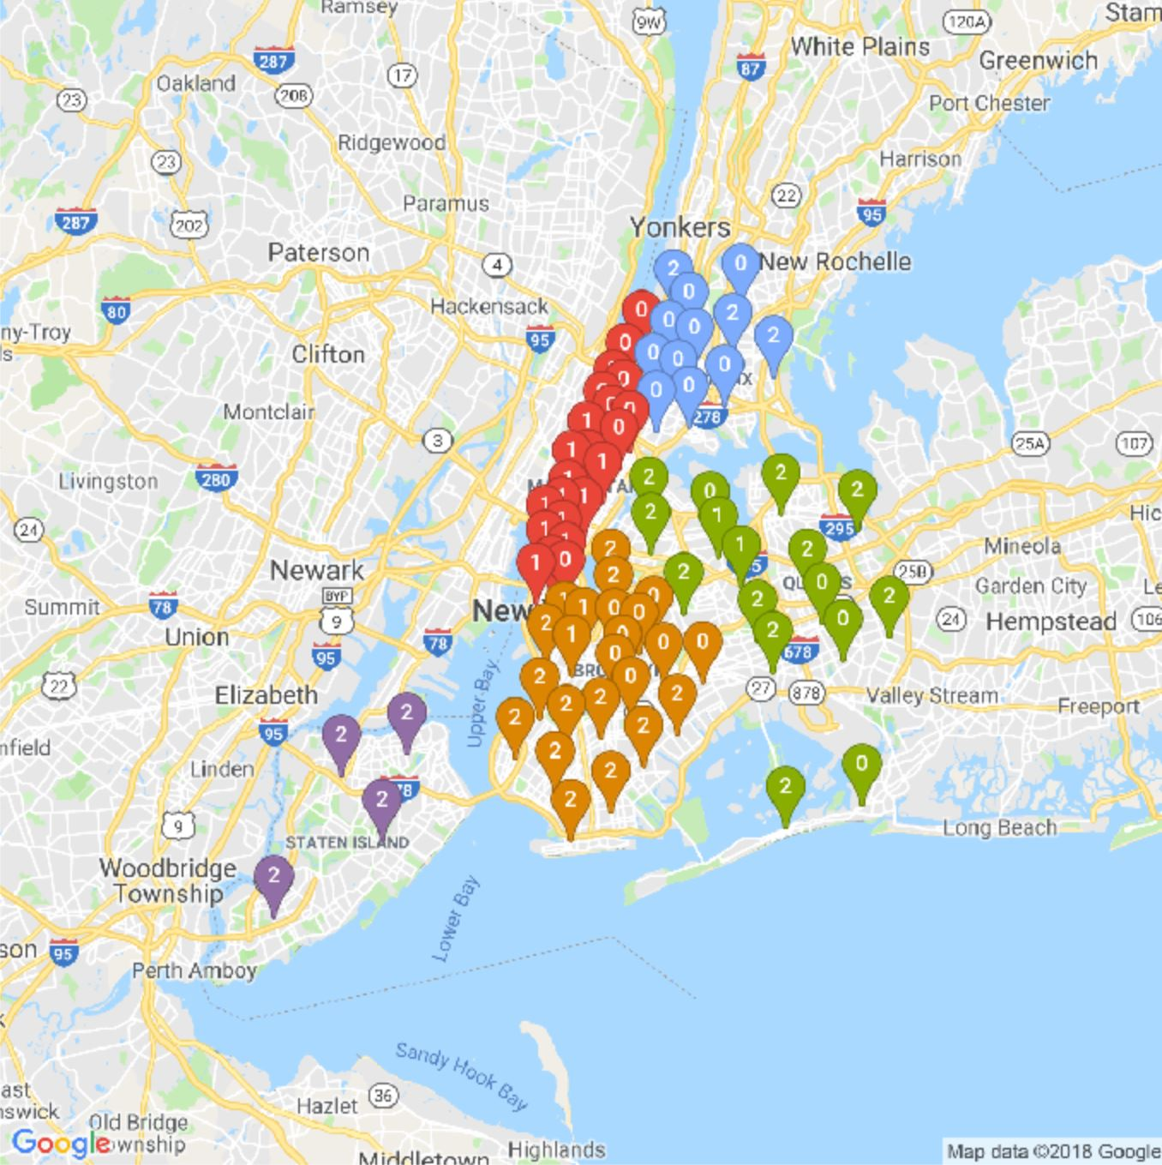
Clustering

Slide 9
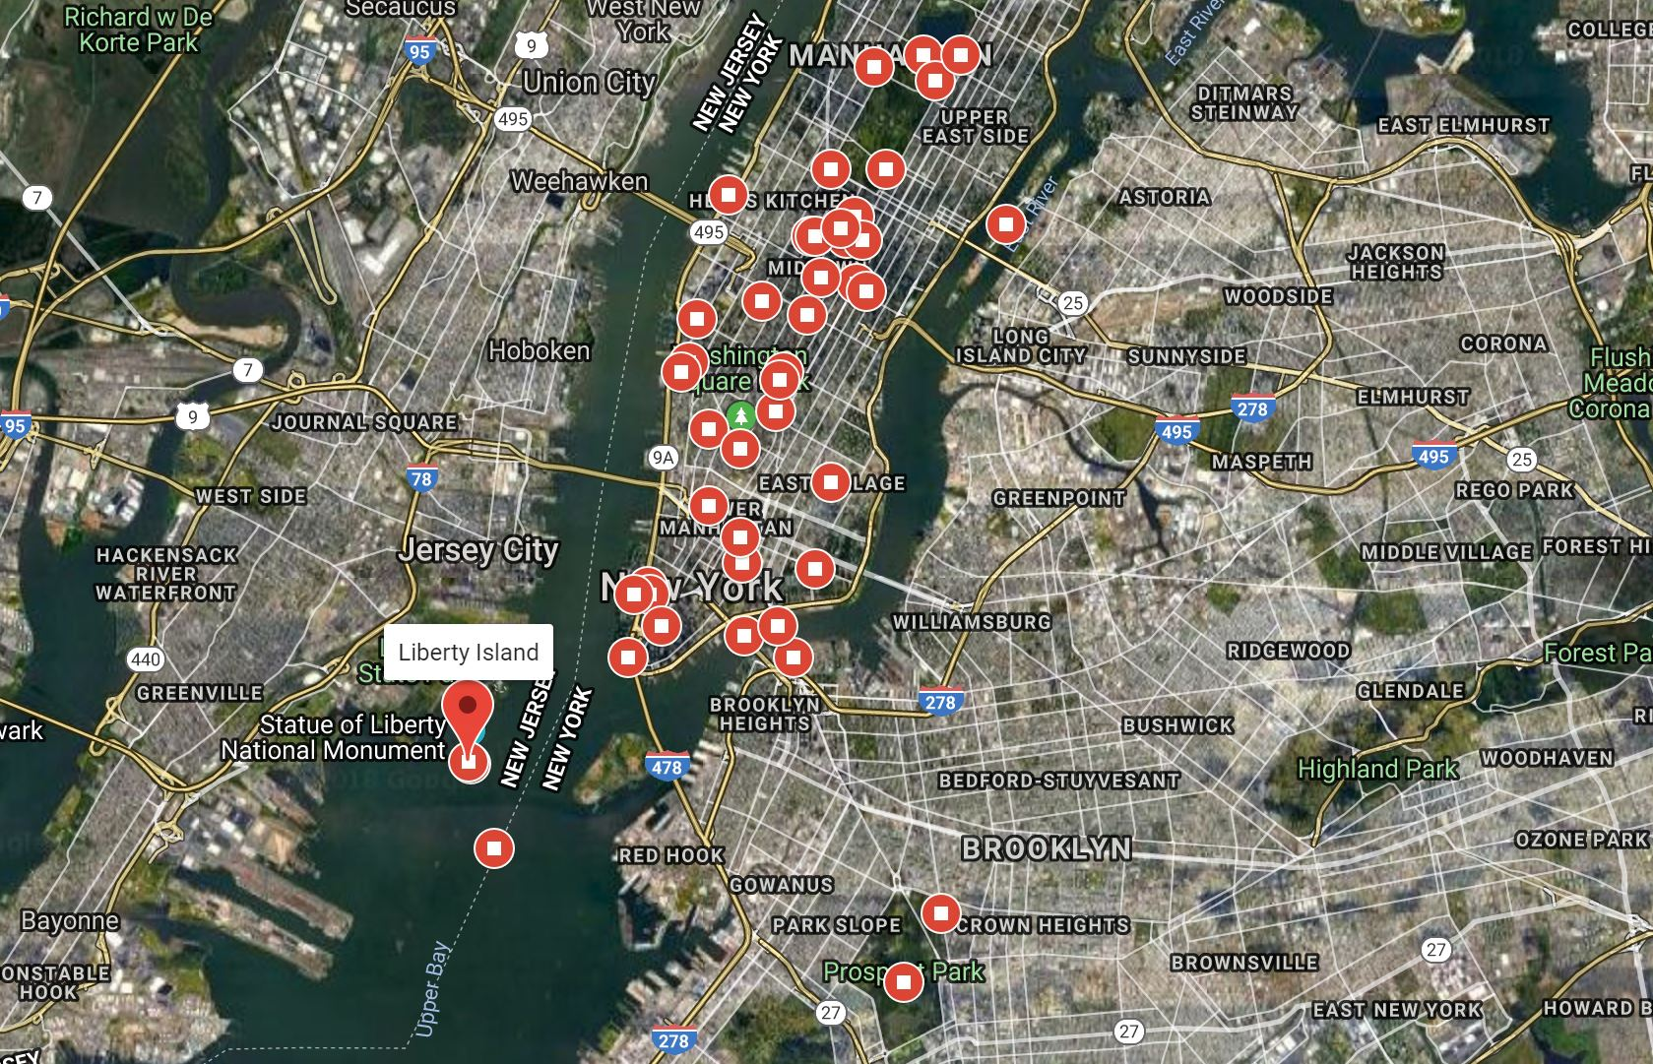
Places you must visit

Slide 10
Discussion
Manhattan being the top tourist destination (having the more number of places to visit) has the second highest crime rate out of the five borough.
Brooklyn has the highest crime rate and has hardly any nice place to visit. So ideal traveller may hardly visit and stay in Brooklyn. Even the data says that it is lot more cheaper to stay in Brooklyn, less tourist are likely to come because of the crime rate.
Analysis is focused on Manhattan, since it is one of the most famous destination tourist are likely to visit.
This project analyzed that an ideal tourist must stay and live close to Staten Island for saving maximum amount of money and time. By choosing this option, one may be close to major attractions, hotels, amenities, etc. at a cheaper rate as compared to the rest of the borough.

Slide 11
Conclusion
This project analyzed that an ideal tourist must stay and live close to Staten Island for saving maximum amount of money and time. By choosing this option, one may be close to major attractions, hotels, amenities, etc. at a cheaper rate as compared to the rest of the city.

Slide 12
Thank you.

